Slide 1
EBC Annual Congress 2014
EIB group support for SMEs
T. Kuhfuss
Palermo, 20 June 2014

Slide 2
The European Investment Bank at a glance
Policy driven EU long term financial institution, created by the Treaty of Rome, share capital held by 28 member states, rated AAA
Largest multilateral lender and borrower in the world
Raises funds on the international capital markets
Passes on favourable borrowing conditions to clients
Some 440 projects financed each year in over 160 countries
More than 90% of lending is inside the EU
Headquarters in Luxembourg and 28 local offices
Around 2 100 staff:
Not only finance professionals, but also engineers, sector economists and socio-environmental experts
2

Slide 3
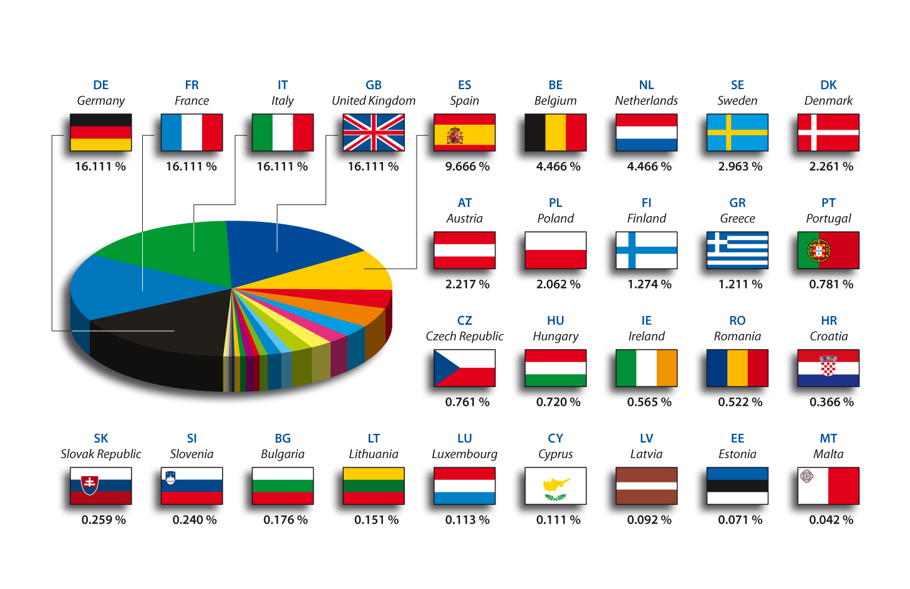
The EIB: capital breakdown
3

Slide 4
2013 key figures
Loans
European Union EUR 64.0 bn
of which Italy EUR 10.4 bn
Partner countries: EUR 7.7 bn
Total lending: EUR 71.7 bn
Borrowings EUR 72.0 bn
Subscribed capital EUR 242.4 bn
4
Notes:
Lending up from EUR 45bn in 2005
AAA Finance Institution:
Strong capital base (own funds EUR 26bn)
Conservative Risk Management
Prudent gearing ratio
High quality loan portfolio
Comprehensive guarantee arrangements

Slide 5
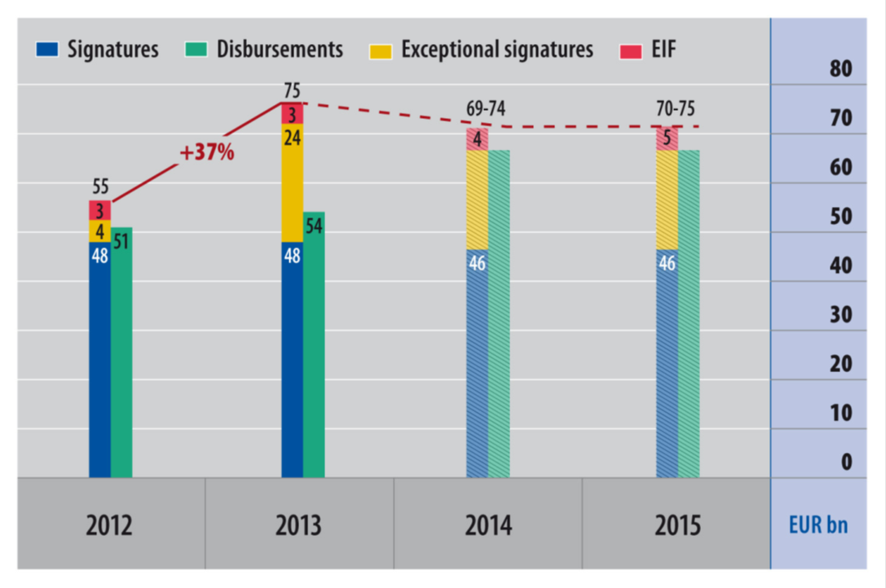
Signatures and disbursements from 2012 to 2015
In June 2012 the European Council approved a EUR 10 bn increase of the EIB capital and in June 2013 a 40% increase in EIB activity over the period 2013-2015 compared to pervious years was approved.

Slide 6
2013 in figures

Slide 7
Investing for Youth – new initiatives in 2013

Slide 8
Financing facilities
Direct loans
Large-scale projects (investment cost > EUR 50m)
Framework loans (investment cost < EUR 50m)
Sector specific loans in particular renewable energy and energy
efficiency
Lending decision remains with the financial intermediary
Midcap loans (investment cost <EUR50m)
Lending decision remains with the financial intermediary
SME loans (investment cost <EUR25m)
Small and medium-scale projects (particularly to SMEs) via national and regional intermediary banks
Lending decision remains with the financial intermediary

Slide 9
Project requirements
All Projects must:
Meet at least one of the EIB’s objectives
Be technically sound
Be financially viable
Show an acceptable economic return
Comply with EU environmental protection and procurement regulations

Slide 10
SME and MIDCAPS
SMEs are an EIB lending priority
The new Loan for SMEs has permitted the Bank to increase its lending volumes to SMEs and to increase transparency in the utilisation of EIB funds:
simplification of the definition of SME (up to 250 employees) and of sectors financed
(all economic sectors financed with limited exceptions such as arms, gambling, tobacco,
real estate etc);
up to 100% financing of investments, incl R&D;
leasing also eligibile;
financing of permanent working capital;
simplification of allocation procedures;
transparency in the utilisation of EIB funds and requirement to transfer a significant quota
of the financial valued added to the SME;
- additionality requirement
extension of the same rules to Midcaps from 2011.
10

Slide 11
SME and midcap loans
Partner bank
Loans
Beneficiary
Beneficiary
Beneficiary
Beneficiary
Beneficiary
Loans for SMEs are the product used to finance SMEs and midcaps through the banking system.
The terms applied to the SME (interest rate, grace period and amortisation schedule) are determined the financial intermediary.
Term of between 5 and 12 years.
Loan up to 100% of project cost with a maximum of EUR 12.5 million.
Transparency and transfer of financial value added contractually verified, allocation period 18 months
Loans available through more than 150 banking groups (30 in Italy), 230 000 SMEs supported
To obtain an EIB loan the SME or midcap should contact one of the EIB intermediaries.
List of EIB intermediaries available on EIB website
11

Slide 12
The European Investment Fund (EIF) Venture capital & SME guarantees
Established in 1994
Owned by:
EIB
European Commission
Other European financial institutions
Resources:
Own funds – subscribed capital
EU programmes
Trust operations (EIB, German Government)
2013 figures (signatures):
Equity: EUR 1 468m
Guarantees: EUR 1 844m
Microfinance: EUR 54m
Portfolio at end 2013:
Private Equity assets under management: EUR 7 904m
Guarantees: EUR 5 574m
Microfinance: EUR 146m

Slide 14
Thank you!
More information at: www.eib.org / www.eif.org
info@eib.org
Phone : +352 4379-22000
14

