Slide 1




Meet BIM4REN: easy-to-use BIM tools for renovation
1. The BIM4Ren webinar series & stakeholders community
Fernando Sigchos, Projects/Communication Manager, European Builders Confederation
2. The construction sector and the need for easy-to-use digitalized tools
Eugenio Quintieri, Secretary General, European Builders Confederation
3. The BIM4Ren concept
Pierre Bourreau, IT Project Manager, Nobatek/Inef4
4. The potential of BIM for renovation
Professor Jakob Beetz, RWTH Aachen University
Follow us!
bim4ren.eu
@bim4ren
BIM4Ren Project

Slide 2

Meet BIM4REN: easy-to-use BIM tools for renovation
Introduction: the B4R webinar series
European Builders Confederation (EBC)
Fernando Sigchos Jiménez

Slide 3
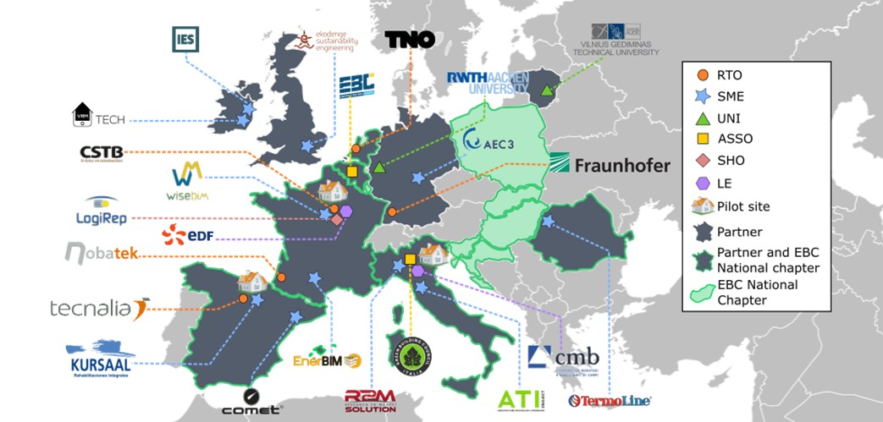
BIM4Ren team
Easy-to-use BIM tools and workflows for collaborative and energy-efficient renovation of residential buildings
Coordinator: Nobatek/INEF4
Consortium: 23 partners from 10 European countries
Duration: 48 months
Start: 1st Oct 2018
Budget: 7M€

Slide 4


BIM4Ren webinar series
First webinar:
- Context of digital construction
- Concept of BIM4Ren
- Challenges for BIM in renovation
Future webinars:
- findings in pilot sites
- research developments
- presentation of tools
- training material
- and many more…

Slide 5
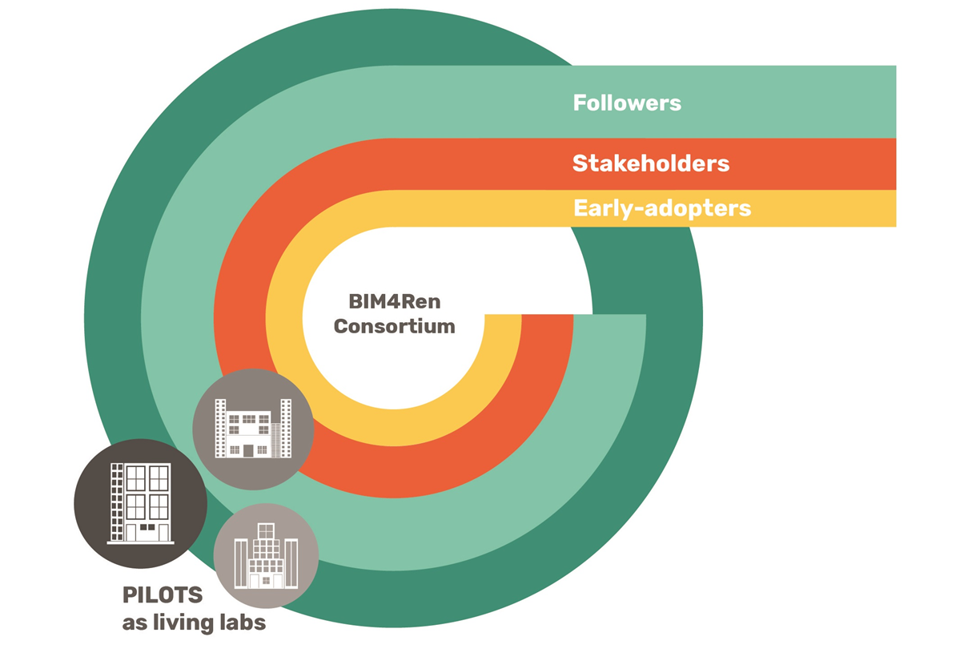
BIM4Ren stakeholders community
The BIM4Ren Stakeholders community: flexible community to participate and/or monitor the project activities
4 categories
Followers = social media, newsletter
Stakeholders = participation to webinars, workshops, training sessions
Early adopters = use of tools & platform
B4R consortium

Slide 6




How to contact us
Webinars 2 & 3:
B4R renovation workflows
3D scanning
Join us!
Participate!
Follow us!
BIM4Ren stakeholders community
contact@bim4ren.eu
Newsletter
Subscribe here
bim4ren.eu
@bim4ren
BIM4Ren Project
Click here to open the survey

Slide 7
Meet BIM4REN: easy-to-use BIM tools for renovation
The construction sector
and the need for easy-to-use digitalized tools
European Builders Confederation (EBC)
Eugenio Quintieri
Webinar – 26/05/2020

Slide 8



The construction sector landscape
Existing buildings are responsible for 40% of the total energy consumption and 38% of GHG emissions
The construction sector:
We need to increase the renovation level of the existing building stock from 1% to 3% !
  Has a very low productivity
  Has a very low use of digital tools
94.1% of the sector is made up of SMEs with less than 10 employees
Digital Transformation is not easily accessible to SMEs and craftsmen.
We need to put adapted tools in the hands of every kind of construction actor.

Slide 9

Where do we stand on digital construction?
Construction is the least digitalised sector (McKinsey – 2016)
In the construction value chain, contractors have the lowest level of BIM adoption and proficiency, with only 23% saying that they are using BIM and only one quarter (24%) indicating that they consider themselves expert or advanced. (McGraw Hill - 2010)
SMEs’ role is not being taken into account by BIM designers and main contractors (University of Huddersfield – 2020)

Slide 10
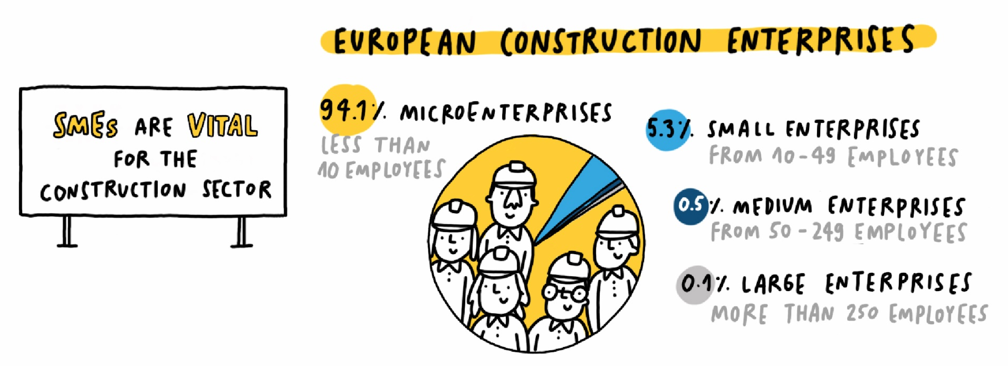


No digital construction without SMEs!
Digital construction cannot be reached without construction SMEs !
Sustainable construction cannot be reached without construction SMEs !

Slide 11


Barriers for SMEs regarding digital tools SMEs
There are several barriers to the large-scale uptake of digital tools among construction SMEs & craftsmen:
Complexity and high number of digital tools
Lack of interoperability between different tools
Software not addressing real needs of small companies
Lack of digital expertise and/or training
Lack of financial means and upfront investments

Slide 12
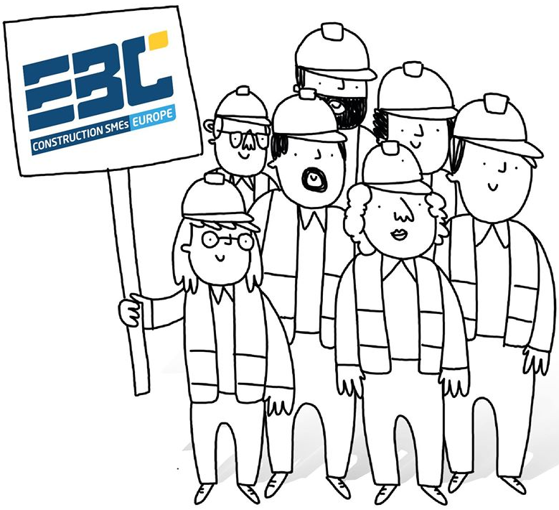
Why EBC joined
To promote the take-up of digital tools by construction SMEs
To obtain a user-friendly and collaborative digital construction sector including all actors
For the benefit of national members that will operate the beta-testing with their SMEs (train-the-trainers programme)
To improve the continuous dialogue between IT & construction companies
Focus on financial accessibility and digital literacy, among main concerns for SMEs

Slide 13

Meet BIM4REN: easy-to-use BIM tools for renovation
The BIM4Ren concept
NOBATEK/INEF4
Pierre BOURREAU
Webinar – 26/05/2020

Slide 14
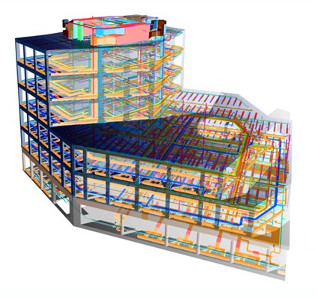
BIM as a trigger for the digital revolution
BIM is both:
  A collaborative process involving the generation and management of a digital representation of a building
  A semantically enriched model to describe a building, covering its lifecycle.
  It allows for a more efficient, collective and integrated design among all stakeholders.
The BIM revolution needs to be available for all the construction value-chain.
BIM has strong potential to improve information management during a renovation and to help overcome process fragmentation and communication problems between stakeholders.
Notes:
Focus on BIM as a methodology.
Demistify BIM.
Digital tools are here to support the collaboration, increase the quality and productivity.
We are not telling people how to make their jobs, but trying to support their activities

Slide 15

BIM in Renovation
BIM is mainly used on new projects
Need to digitize existing buildings (not just scanning)
Need a suitable model (IFC extension)…
… Usable in the construction & exploitation phases
BIM and Renovation: a complementarity
Can be combined with Energy Audit interventions
Different depths of renovation projects
Different Information for different projects

Slide 16














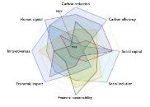

BIM4Ren concept
Data Management
Data collection
Data- driven design
WHAT IS THE EXISTING DATA ?
Year?
Local regulation?
Cost € ?
Energy performance?
Geometry?
Stakeholders expectations?
Type of occupants ?
Renovation potential ?
State of the existing infrastructure ?
Stakeholders involved in the renovation
Notes:
Main different with new projects: the project starts with an existing asset.
The initial model is not a sketch of what should be BUT an image of what the building is.
What + How: digitizing a building // energy audit

Slide 17
BIM4Ren concept
Digital inputs
Data Management
Data collection
Data- driven design
WHAT IS THE EXISTING DATA ?
To create the BIM model
To organize, consolidate, secure
To validate the BIM model
Stakeholders involved in the renovation
Notes:
Different types of projects, different types of models.
Renovation depth ---→ level of information scale
The model needs to be validated so it is usable by other software.

Slide 18
BIM4Ren concept
Digital inputs
Data Management
Exploit BIM
Data collection
Data- driven design
WHAT IS THE EXISTING DATA ?
To create the BIM model
To organize, consolidate, secure
To exploit the BIM model
Stakeholders involved in the renovation

Slide 19
BIM4Ren concept
Data Management
Data collection
Data- driven design
BIM4REN ONE STOP ACCESS PLATFORM
Stakeholders involved in the renovation
Notes:
A single entry point to the project, to ease the use of the softs.
Digital toolbox.

Slide 20
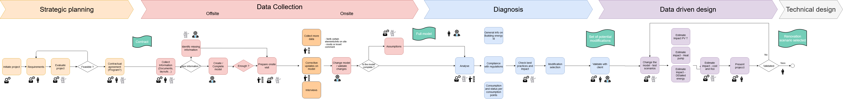
Objectives – BIM4Ren worklow
To propose a flexible collaborative workflow for renovation
  Different types of buildings
  Different depth of renovation
  Different actors and expectations

Slide 21
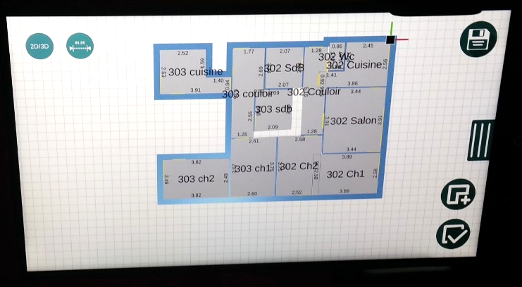
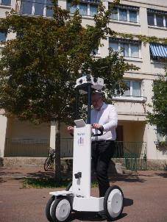
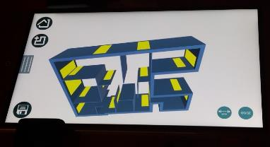
Objectives – adaptable easy to use tools
To support the workflow with digital tools
  Test and Integrate existing tools
  Extend IFC
  Different projects => different tools
    Expert tools vs Intuitive & Affordable ones (low-end vs high-end)
Example of scanning tools that were tested:
NAVVIS by BIMY
AR2Built by BIMEO

Slide 22
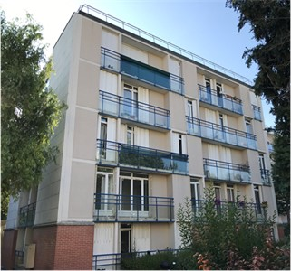
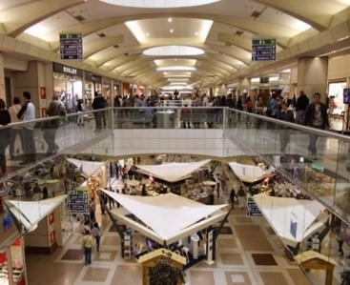
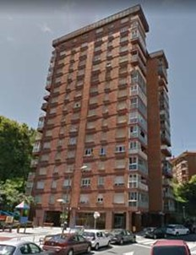
Objectives – to test on pilots as real use cases
To test the workflow and tools on real use cases
To contribute to the next IFC roadmap
To train professionals
France
Italy
Spain

Slide 23






BIM4Ren - ACTIONS
Collect requirements
Elaborate a flexible collaborative workflow
Develop and integrate tools supporting the BIM4Ren workflow
Test on real use cases
Evaluate the results
Train

Slide 24

Meet BIM4REN: easy-to-use BIM tools for renovation
The potential of BIM for renovation
RWTH Aachen University
Jakob BEETZ
Webinar – 26/05/2020

Slide 25
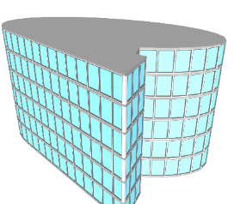
Existing buildings in the BIM Lifecycle
Design
Planning
Spatial allocation
Variant Design
Cross-domain coodrination
Conceptional Design
Cost estimation
Simulations, Calculations
Demolition
Refurbishment
Construction
Building Information Model
4D Simulation
Recycling
Revitalization
Construction site logicstics
Accounting
Operation
Facility Management, Maintenance
Source: Borrmann, A., König, M., Koch, C., & Beetz, J. (Eds.). (2018). Building Information Modeling; 1st ed. Springer International Publishing.

Slide 26
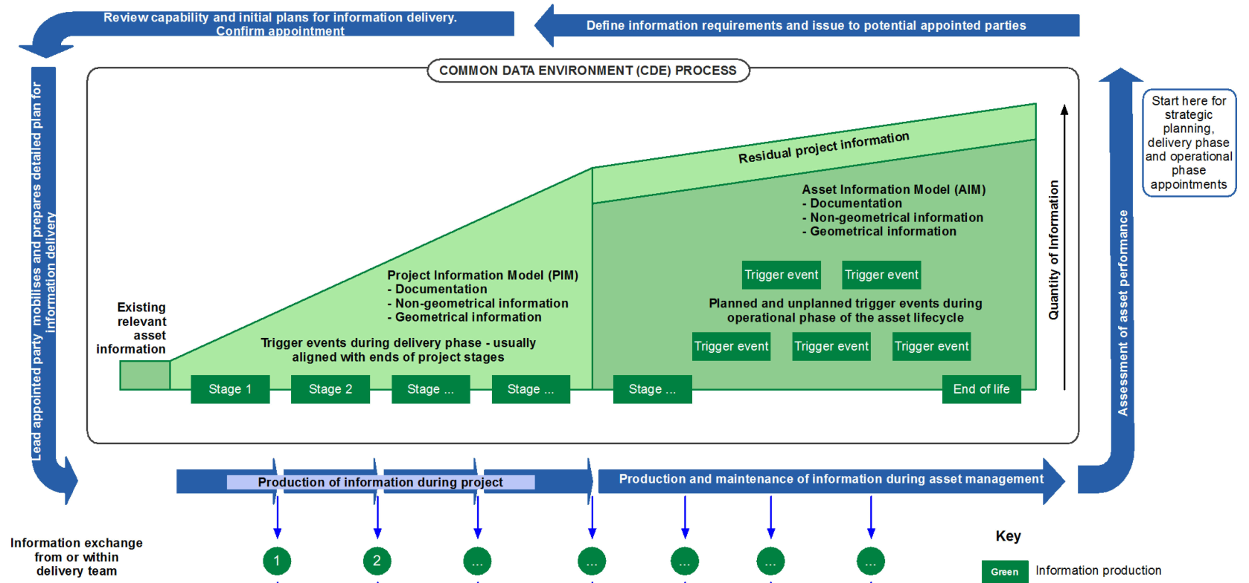

Existing Buildings in BIM ISO 16560
ISO 16560

Slide 27
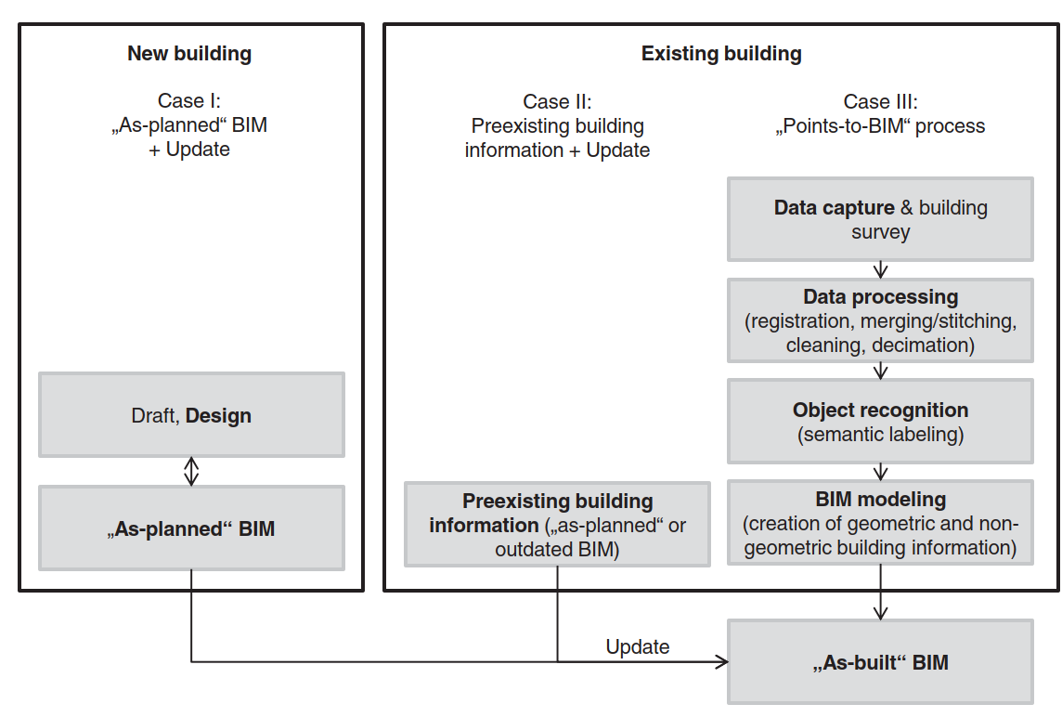
Existing Buildings in BIM: Scenarios
Source: Volk, R., Stengel, J., & Schultmann, F. (2014). Building Information Modeling (BIM) for existing buildings—Literature review and future needs. Automation in Construction, 38, 109–127.

Slide 28
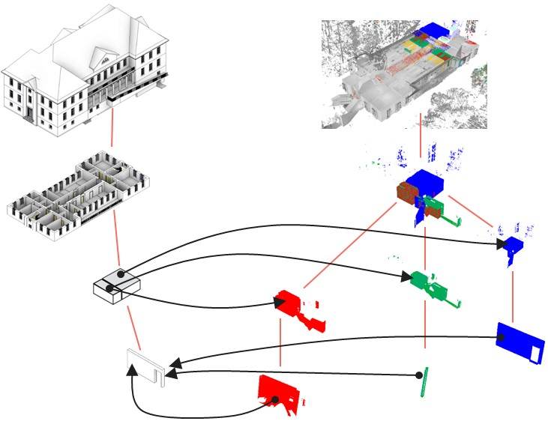
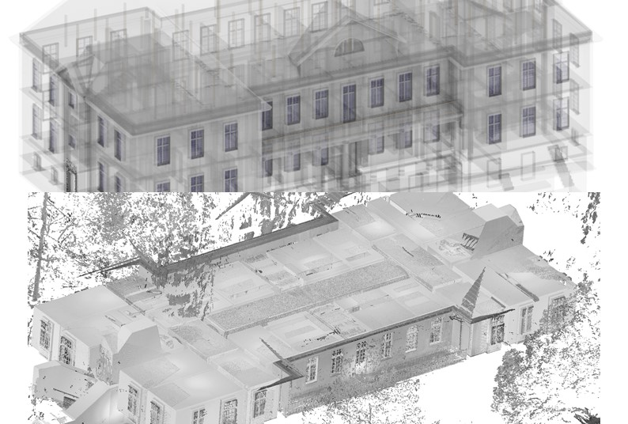
Existing Buildings in BIM: Scan-to-BIM, as-built / as-planned
Krijnen, T., & Beetz, J. (2017). An IFC schema extension and binary serialization format to efficiently integrate point cloud data into building models. Advanced Engineering Informatics, 33(Supplement C), 473–490..

Slide 29
Existing buildings in BIM
Level 0
Level 1
Level 2
Level 3
iBIM
BIMs
AIM
SIM
FIM
IDM, IFC, IFD
BSIM
2D
3D
BRIM
Proprietary
Formats
Proprietary formats + COBie
Exchange Formats
CAD
ISO standards
Coordinated Discipline-
specific
BIM models
Depth of information
Geometric
models
Integrated, interoperable
Building Information Models for the entire life-cycle
Drawings
Paper
File-based
collaboration
Central manage-ment of files (Common Data Environment),
Shared libraries
Cloud-based
model management
(BIM Hub)
Coordination and
Collaboration
Source: Borrmann, A., König, M., Koch, C., & Beetz, J. (Eds.). (2018). Building Information Modeling; 1st ed. Springer International Publishing.

Slide 30
Questions
&
Answers

Slide 31
Let’s chat!
Join us!
BIM4Ren stakeholders community
contact@bim4ren.eu
Newsletter
Subscribe here
Q & A is open!
Type your question in the chat box
Mention to whom you address the question
Follow us!
bim4ren.eu
@bim4ren
BIM4Ren Project
Your question wasn’t selected?
You’ll get an email reply soon enough!

Slide 32
Thank you for your attention

